Slide 1
Civi Et Republicae The Residential College and the 'Architecture of Democracy' in the Civic University
Keith Gaddie Senior Fellow, The Headington College Presidential Professor & Chair of Political Science The University of Oklahoma

Slide 2
We shape our buildings,
and
afterwards our buildings shape us.
Winston Churchill

Slide 3
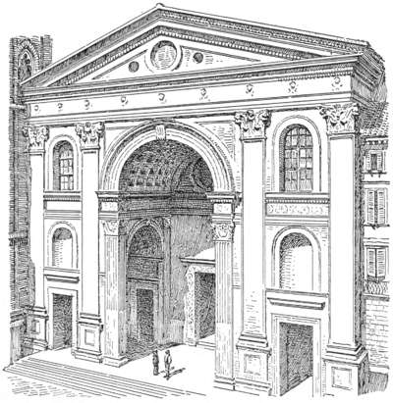
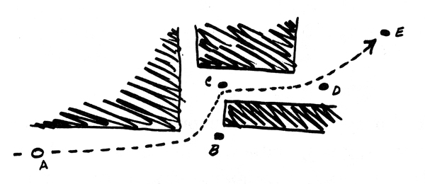
Building: Evidence of Technology

Slide 4
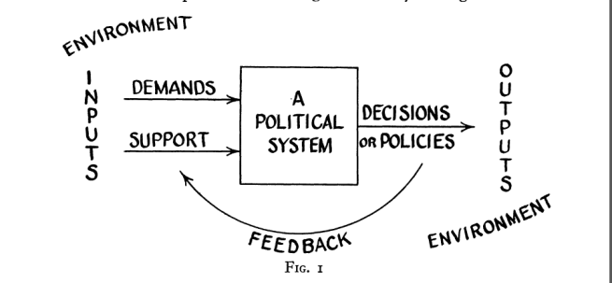
Systems: Evidence of Technology

Slide 5
Perimeter
Outside the building
Circulation
Hallways, corridors, rotunda space
Civic
Courtrooms, legislative chambers
Operational
Staff support
Audience
Intimate meeting space
Sanctums
Lawmaker, executive offices

Slide 6
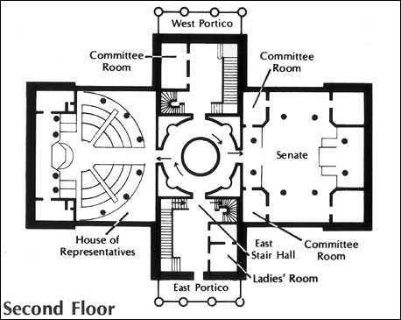

Slide 7
Moving To a New Openness
A Look for New Democratic Forms

Slide 8
The Challenge to Democracy, to Constructive Communication, to Education, and to Modern Life Resides in Creating Social Capital.
How do we use the college experience to build meaningful social capital?

Slide 9
“Sound scholarship, good citizenship, and the duties of the individual to the community and the state – briefly, these are the points emphasized in the University[ of Oklahoma]’s teaching.” WPA Guide to Oklahoma, 1940

Slide 10
Residential College
“Yale Model"
Intellectual, Social and Cultural
Sophomore, Junior and Senior
Decentralization and Diversity
Faculty Leadership and Engagement
Student Governance
Traditions - Teas and High Tables
Dining Central to Community Experience
Seminar Program (2-hr credit courses)

Slide 11
Residential College
“Oklahoma Model"
Intellectual, Social and Cultural
Sophomore, Junior and Senior
Decentralization and Diversity
Faculty Leadership and Engagement
Student Governance
Traditions - Teas and High Tables
Dining Central to Community Experience
Seminar Program (1-hr credit courses)

Slide 12
Governance
College Council
Hall Council
Faculty Fellows Council
Council of Senior Fellows

Slide 13
Scholarship
Residential College Seminars
Residential College Courses
Normal Discipline Courses taught by Faculty Fellows
Experiential Learning
Study Abroad
Intership
Research & Creative Activity
Destination Education

Slide 14
Transforming a Campus

Slide 15
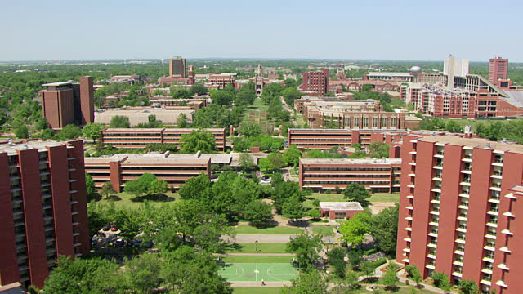

Slide 16
There is abundant evidence to show that high buildings make people crazy.
Christopher Alexander, A Pattern Language: Towns, Buildings, Construction

Slide 17
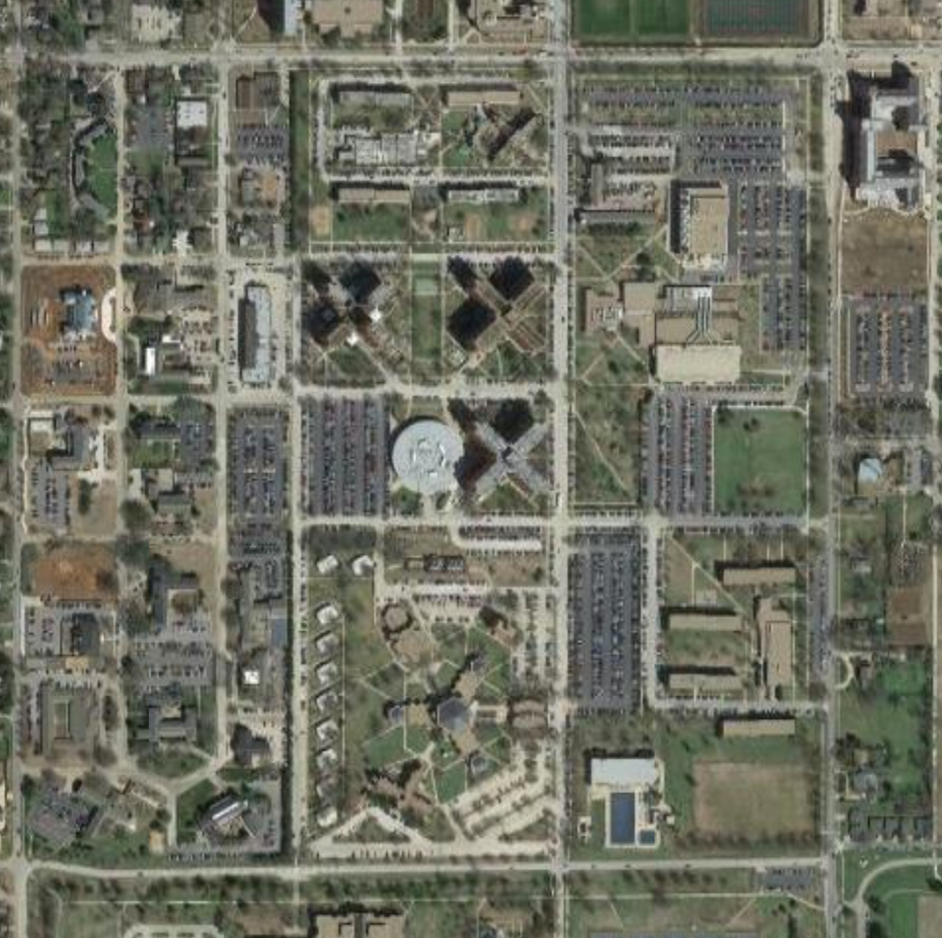
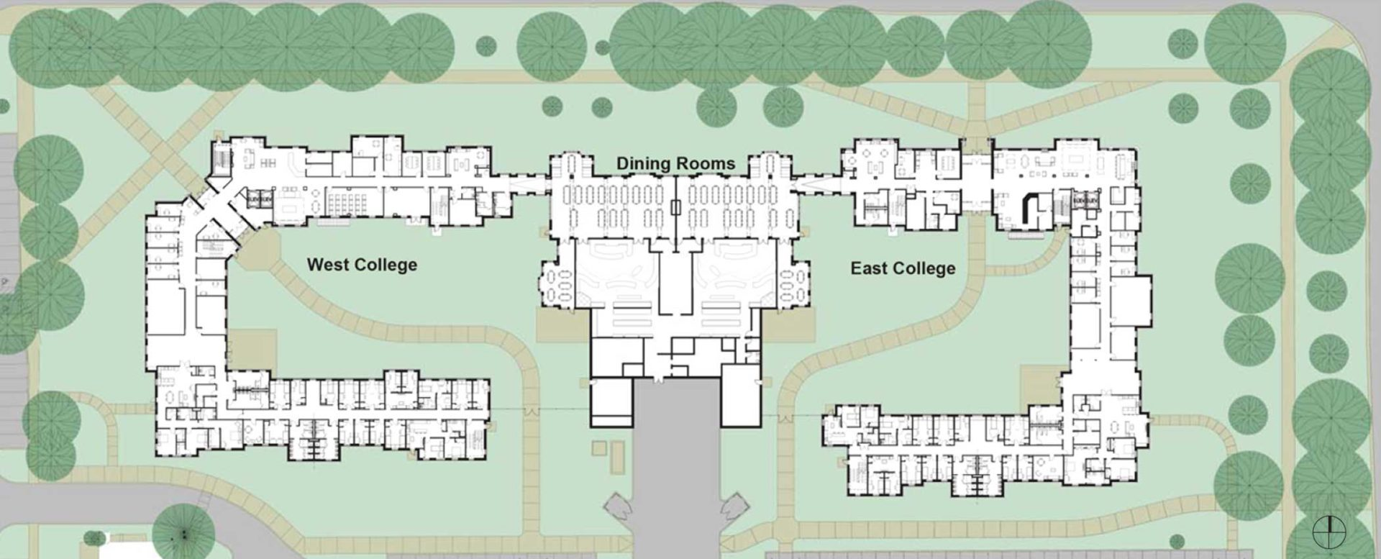
Dunham & Headington Colleges
South Greek
N

Slide 18
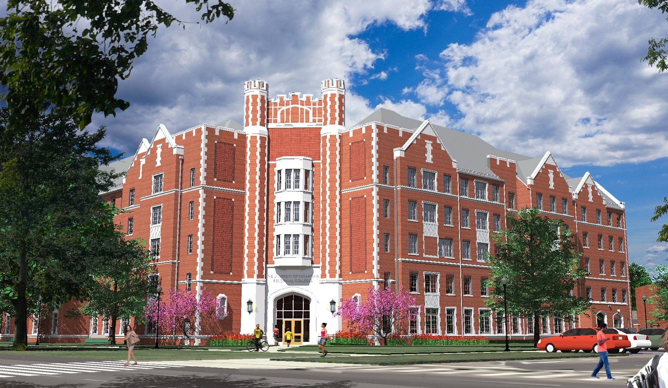
Dunham College
2017

Slide 19
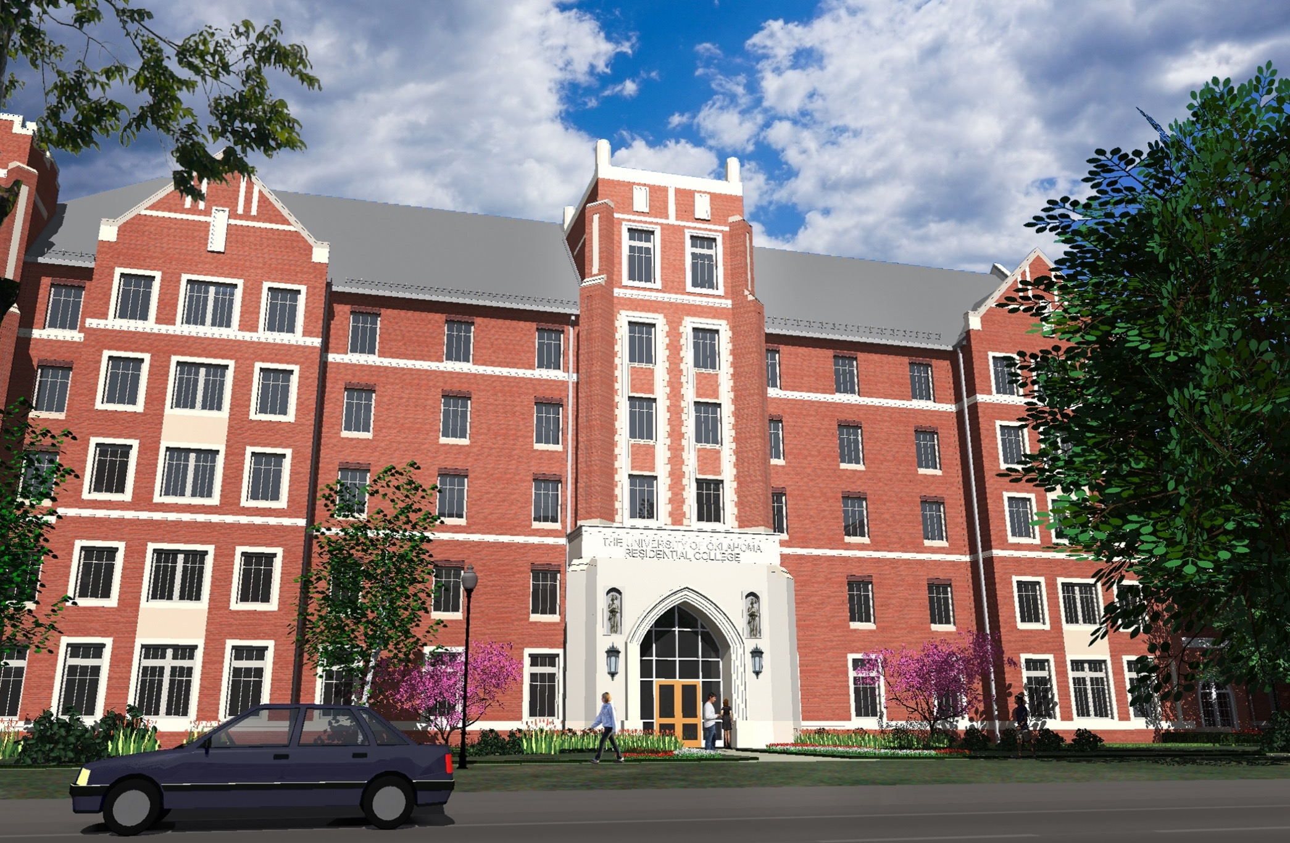
Headington College
2017

Slide 20
Dunham & Headington Colleges
Cross Village
N
Faculty offices
Collaborative learning & creator spaces
Faculty IR
New garages

