Slide 1
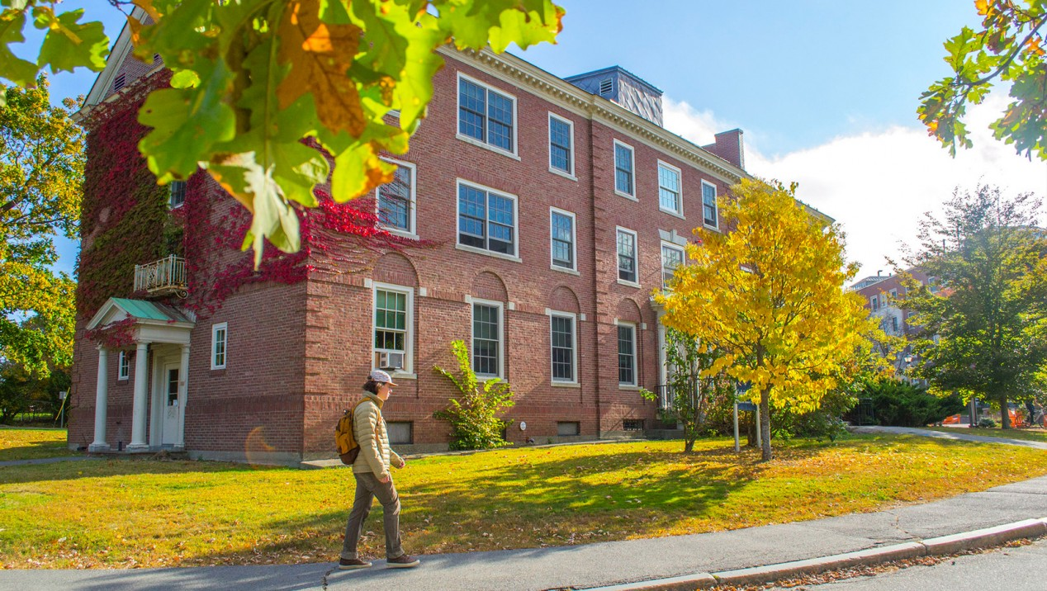
Honors Collegiate Way: Excellence, Innovation, and Engagement
(2nd Collegiate Way International Conference, Canberra, Australia, November 13-17, 2016)
François G. Amar
Dean, Honors College
University of Maine

Slide 2
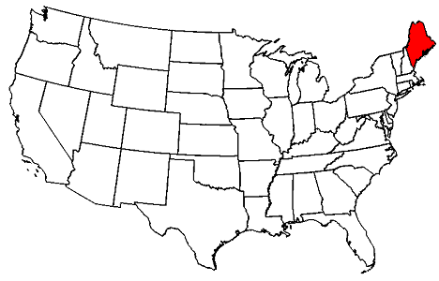
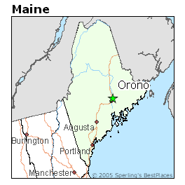
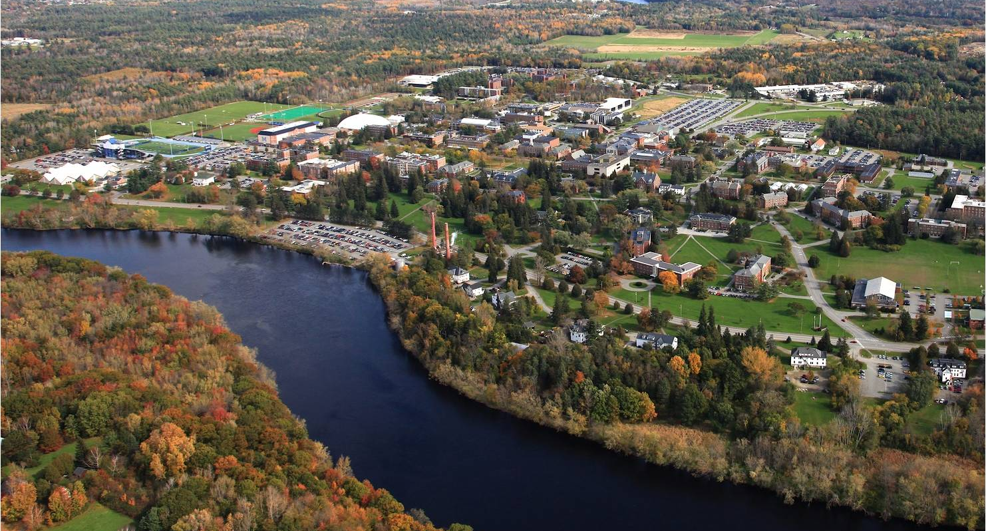
Maine’s Land & Sea Grant University
Founded in 1865: the state’s only RU/H institution
Original campus designed by Frederick Law Olmstead
9297 undergraduates in 100 majors & academic programs
1625 graduate students in 70 Master’s & 30 Doctoral programs
Maine’s only NCAA Division I athletics program with 84 individual & team conference championships in the last 10 years

Slide 3
Honors Education
The Honors College at the University of Maine promotes academic excellence, community engagement, and access to global opportunities.
We also champion the liberal arts core while serving as a hub for interdisciplinary work in a research intensive university.

Slide 4
What goes on in Honors at UMaine?
The Honors core curriculum complements students' programs and integrates with all majors.
Honors students complete a core sequence of
  four interdisciplinary Honors courses,
  a third-year Honors tutorial,
  a 2-semester independent Honors thesis
Completion of the Honors curriculum meets the University general education requirements.
Extra-curricular and service opportunities
83 members of the class of 2016 wrote and successfully defended a thesis.
Notes:
Next NCHC

Slide 5
What does NCHC consider a
Fully Developed Honors College?
NCHC outlines 13 points:
The first assumes the features of a fully developed honors program.
About half refer to governance, reporting, and budgetary issues including development.
Three refer to curriculum and reporting of completion
One refers to honors residential options
The last refers to program assessment
Notes:
Perhaps the key feature of an Honors program is that it should control between 15 and 25 per cent of the student’s credit hours. At Umaine, Honors covers 27 of 120 credits needed to graduate or 22.5%.

Slide 6
Governance, reporting, and budget:
A fully developed HC has the status and
resources of other Colleges of the University
h Students: 850 over all four years
h Staff: Five full-time and one half-time
h Faculty: Mix of full-time and part-time

Slide 7
Curriculum:
A fully developed HC governs a significant
portion of the students’ curriculum.
27 credits in Honors out of 120 to graduate
Honors core covers General Education
requirements (except for math and science)
Honors thesis usually covers capstone

Slide 8
Residential component:
Significant footprint within the
institution’s framework for on-campus living
hThree Honors-only dorms with about 200 beds, several with seminar classrooms. Thomson Honors student center in Colvin Hall.
hDeveloping relationship with Residential Life (Living-Learning Community structures)

Slide 9
Theses vs year
Notes:
Begun by Philosophy Prof. Ronald Levinson in 1935, Honors classes at UMaine were personalized (often individual) tutorials offered to promising students by invitation.

Slide 10
Research
Fellowships and scholarships for research
Research clusters
  Genomics
  Food systems
Strong ties to UMaine Center for Undergraduate Research (CUGR)
Rigorous thesis process

Slide 11
HON 150/155
Phage Genomics
A research course for
first-year students
Supported by
National Institutes of Health
and the
Howard Hughes Medical Institute

Slide 12
Sustainable Food Systems Research Collaborative
On-ramp to research for sophomores and juniors
Honors as hub for interdisciplinary conversation about Food Systems
Host seminars, organize workshops, send students to conferences, publish on SFS
Honors tutorial course on SFS
Enhance our ability to attract funding, students, faculty, and community partners
Engage the UMaine Honors College community in important work at the local, regional, national and international levels.
Eight+ Honors theses in SFS in 3 years

Slide 13
Where do we fit?
Big university resources but small college feel
Honors features small classes and personalized attention by faculty
The core
Excellent research, internship and co-op opportunities
Beautiful campus and easy access to outdoor activities year round

Slide 14

A sumptuous harvest, enriching my life
I was blessed, more than 50 years ago, to be a student of the early Honors Program at the University of Maine. The intellectual impact has not waned to this day. It broadened my horizon immeasurably, enabling me to commune with the substantial ideas from diverse ages and cultures. That early seeding of ideas has resulted in a sumptuous harvest, enriching my life to this day.
Bernard Lown, M.D. ’42
Nobel Peace Prize 1985

